Slide 1
Data Modelling, Management & Governance
CIS108-6
UML Class Diagrams
Gangmin Li

Slide 2
DATA MODELLING, MANAGEMENT AND GOVERNANCE
CIS108-6
Lecture 2: Software System Design Methods UML
2.3 Object-Oriented Modelling and Class Diagrams
Gangmin Li

Slide 3
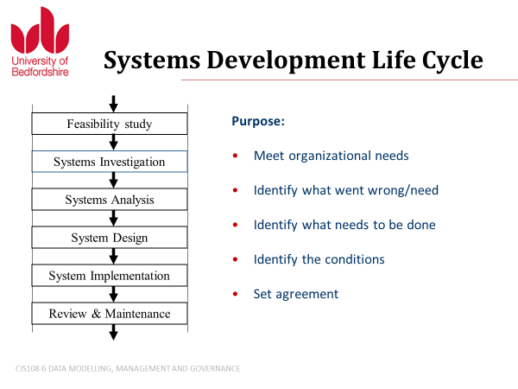
What have we learnt?
Lecture 1 - Data, Information, Knowledge, Wisdom (DIKW) ; Information Systems and Data Management; Database management systems (DBMS); Information system Development

Slide 4
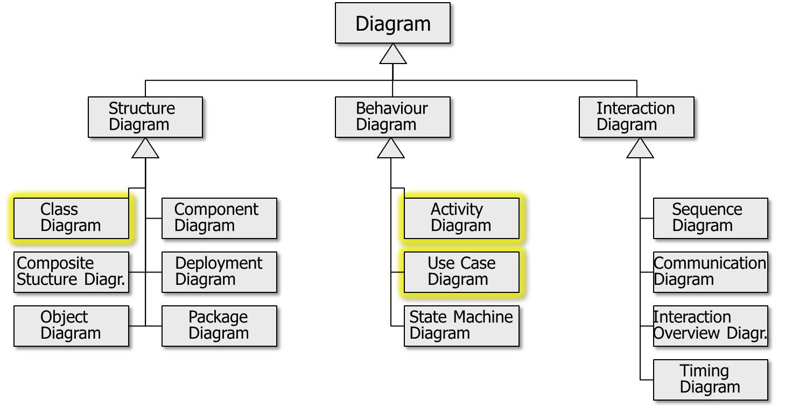
What have we learnt?
The Unified Modelling Language (UML)- The Unified Modelling Language (UML) is a general-purpose, developmental, modelling language in the field of software engineering that is intended to provide a standard way to visualize the design of a system.

Slide 5
Last Week’s Exercises

Slide 6
Exercise 1
Given the following restaurant scenario,
Identify actors and use cases;
Draw a Use Case Diagram reflecting the scenario!
In a restaurant, a guest can order and then eat a meal. A waiter can take orders and deliver the bill. A guest can pay the bill either by credit card or cash. Credit card payment includes checking the credit card by a credit card company.

Slide 7
Restaurant Use Case Diagram
Restaurant
ne
Order
Meal
Bring Bill
Waiter
Eat Meal
Guest
Pay
Bill
Pay
Cash
<<include>>
Pay with
Credit Card
Check
Card
Credit Card
Company

Slide 8
Exercise 2
Also please create an activity diagram for the Authenticate Use Case description presented at the beginning of this lecture!

Slide 9
Authenticate Use Case
Main flow of events (success sequence)
The ATM prompts the card holder for the PIN
Card holder inputs PIN
ATM verifies PIN
ATM requests authorisation from an authorisation system
Authorisation system confirms authorisation
The ATM authorises the card holder

Slide 10
Authenticate Use Case
Alternative Sequence
A1: 1st or 2nd time wrong PIN (starts at point 4 of main flow)
ATM informs card holder that the PIN is incorrect for the 1st or 2nd time
The scenario goes back to point 1

Slide 11
Authenticate Activity Diagram
Prompt
Card Holder
PIN
inserted
Verify
PIN
Prompt
3rd Incorrect
PIN
[PIN wrong 1st
or 2nd time]
<<Pre-condition>>
Card inserted
Prompt
Incorrect
PIN
[PIN wrong
3rd time]
<<Post-condition>>
User not authenticated
[else]
Confiscate
Card
Request
Authorisation
<<Post-condition>>
User authenticated
[Auth.
OK]
[else]
Authorise
user
Receive
response
<<Post-condition>>
User not authenticated

Slide 12
UML Diagrams (in UML)
Diagram
Structure
Diagram
Behaviour
Diagram
Interaction
Diagram
Class
Diagram
Component
Diagram
Activity
Diagram
Sequence
Diagram
Composite
Stucture Diagr.
Deployment
Diagram
Use Case
Diagram
Communication
Diagram
Object
Diagram
Package
Diagram
State Machine
Diagram
Interaction
Overview Diagr.
Timing
Diagram

Slide 13
UML Class Diagrams

Slide 14
Lecture outline
What is UML Class Diagram?
The basic Concepts of Object-oriented systems
Class representation in UML
Relationships between classes and UML notations

Slide 15
UML Class Diagrams
  A graphical notation used to construct and visualize object-oriented systems by show:
    The (objects) classes of the system
    Attributes (objects)
    The relationships (among objects)
    their operations (or methods)
  UML Class diagrams are used for a wide variety of purposes, including both conceptual/domain modeling and detailed design modeling

Slide 16
Object-oriented Concepts
Object: an object represents a natural existence with its properties, shows what it is and what it can do.
In computer science an object is a data structure defined by its attributes and serves a separate function operate on data. An object can be part of a class.
Class: A tight coupling or association of data structures with the methods or functions that act on the data. It also called object in a sense of that an object can be created based on a class （- instantiation) . A class is a set of objects that are similar （in attributes or functions).

Slide 17
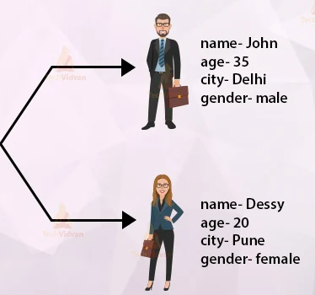
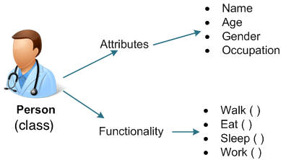
Example

Slide 18
Classes/Objects and Instances
Objects are instances of classes
Instances of one class share certain attributes
Example: A car is a class; your car is a particular instance of it
Find other examples here in this room!

Slide 19
Class representation in UML
A Class is a blueprint for an object. Objects and classes go hand in hand. We can't talk about one without talking about the other. And the entire point of Object-Oriented Design is not about objects, it's about classes, because we use classes to create objects. So a class describes what an object will be, but it isn't the object itself.
In fact, classes describe the type of objects, while objects are usable instances of classes. Each Object was built from the same set of blueprints (class) and therefore contains the same components (properties and methods). The standard meaning is that an object is an instance of a class and object – (Objects have states and behaviours).

Slide 20
Class Representation in UML
The UML representation of a class is a rectangle containing three compartments stacked vertically:
    The top compartment shows the class's name
    The middle compartment lists the class's attributes
    The bottom compartment lists the class's operations/methods
Class Name
Class Attributes
Class operations and
methods

Slide 21
Airline Flight as UML Class
Flight
The name is: Flight
The Flight class has three attributes:
  flightNumber,
  departureTime, and
  flightDuration
The Flight class has two operations:
  delayFlight and
  getArrivalTime
flightNumber: Integer
departureTime: Date
flightDuration: Minutes
delayFlight (numberOfMinutes: Integer) : Date
getArrivalTime(): Date
Operations are shown in the third partition. They are services the class provides.
The return type of a method is shown after the colon at the end of the method signature.

Slide 22
Attribute Section
Attribute section in the middle compartments
Lists each of the class’s attributes on a separate line as
The attribute type is shown after the colon.
Attributes map onto member variables (data members) in code (OO Programming).
name : attribute type
Flight
Name
flightNumber : Integer
departureTime : Date
flightDuration : Minutes
Attribute
Type
delayFlight (numberOfMinutes : Integer) : Date
getArrivalTime() : Date

Slide 23
Attribute types
Attribute types usually correspond to units that make sense to the likely readers of the diagram (i.e., minutes, dollars, etc.) – domain related.
Class diagrams to generate code
  Attribute types are limited to the
    types provided by the programming language, or
    types included in the model (i.e. other classes) that will also be implemented in the system

Slide 24
Attribute default value
It is often useful to show on a class diagram that a particular attribute has a default value
  For example, in a banking account application a new bank account would start off with a zero balance
The UML specification allows for the identification of default values in the attribute list section by using the notation:
name : attribute type = default value

Slide 25
Default Value Example
A Bank Account class showing the balance attribute's value defaulted to zero dollars
BankAccount
owner : String
balance : Dollars = 0
deposit (amount : Dollars)
withdrawal (amount: Dollars)

Slide 26
Class Operation (methods) List
Documented in the third (lowest) compartment of the class diagram's rectangle
Displayed in a list format, with each operation on its own line
Operations are documented using the notation
Name (parameter list) : type of value returned

Slide 27
Example of Class Operations List
Flight
flightNumber : Integer
departureTime : Date
flightDuration : Minutes
Name
delayFlight (numberOfMinutes : Integer) : Date
getArrivalTime() : Date
Return Type
Parameter List

Slide 28
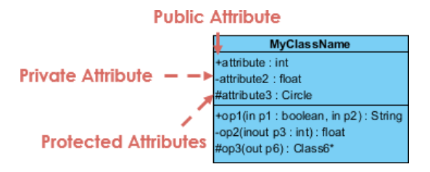
Class Visibility
The +, - and # symbols before an attribute and operation name in a class denote the visibility of the attribute and operation.
+ denotes public attributes or operations
- denotes private attributes or operations
# denotes protected attributes or operations

Slide 29
Examples of Class Operations List
Private Attribute
Public Attribute
Flight
+flightNumber : Integer
-departureTime : Date
#flightDuration : Minutes
-delayFlight (numberOfMinutes : Integer) : Date
+getArrivalTime() : Date
Protected Attribute

Slide 30
Parameter Directionality
Each parameter in an operation (method) may be denoted as in, out or inout
This specifies its direction with respect to the caller.
This directionality is shown before the parameter name.

Slide 31
Parameter Directionality
in parameters are set by the caller and passed to the function, but remain unchanged
input parameters are set by the caller and passed to the operation. They are then possibly modified passed back out
out parameters are not set by the caller but are modified and passed back out

Slide 32
Parameter Directionality
Calling class must set par1 and pass to op1, and it remain unchanged by op1.
MyExampleClass
par2 should be set within op1 method and is returned
to calling class.
attr1 : Integer
attr2 : String
attr3 : Date
op1 (in par1 : Integer, out par2 : String) : Date
op2 (input par3 : Integer)
par3 must be set by calling class,
but is modified by op2.
op2 does not have any other return value (but could have)!

Slide 33
Relationships between classes

Slide 34
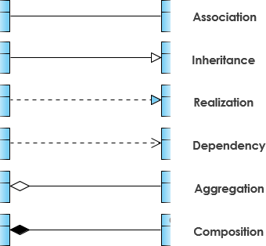
Relationships between classes in UML

Slide 35
Inheritance
Inheritance shows a taxonomic relationship between a more general class and a more specific class. The specific class inherits the features of the more general class.
Inheritance also refers to the ability of one class to inherit the identical functionality of another class and then add new functionality of its own
To model inheritance on a class diagram, a solid line is drawn from the child class (the class inheriting the behavior) with a closed, unfilled arrowhead (or triangle) pointing to the super class

Slide 36
Inheritance Example
Types of bank accounts
CheckingAccount and SavingsAccount classes inherit ‘owner’, ‘balance’ and ‘deposit’ from the BankAccount class
‘withdrawal’ method is overloaded
additional methods and attributes defined
BankAccount
owner: String
balance: Dollars
deposit (amount : Dollars )
withdrawal (amount : Dollars)
CheckingAccount
SavingsAccount
insufficientFundsFee : Dollars
annualInterestRate : Percentage
processCheck (checkToProcess : Check)
withdrawal (amount : Dollars)
depositMonthlyInterest ( )
withdrawal (amount : Dollars)

Slide 37
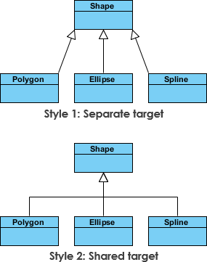
Another Inheritance Example
Although the connectors are drawn differently, they are semantically equivalent.

Slide 38
Associations
  During modeling certain objects will be related to each other, and these relationships themselves need to be modeled for clarity
  Different types of associations:
    Bi-directional
      Indicated by a solid line between the two classes
      At either end of the line, you place a role name and a multiplicity value
    Uni-directional
      Two classes are related but only one class knows that the relationship exists
      Drawn as a solid line with an open arrowhead pointing to the known class

Slide 39
Bi-directional Associations
  The Flight is associated with a specific Plane, and the Flight class knows about this association. The Plane takes on the role of "assignedPlane" in this association because the role name next to the Plane class says so
  A Plane knows about its association with the Flight class. In this association, the Flight takes on the role of "assignedFlights”
A plane can be assigned to an
unlimited number of flights (‘*’), but can also be assigned to no
flight at all (‘0’). ‘..’ denotes the
possible range.
Planes have the role of
“assigned planes” from a flight’s perspective.
A flight can only be operated by one plane. There may be no
plane assigned to a flight yet.
Flight
Plane
flightNumber : Integer
departureTime : Date
flightDuration : Minutes
departingAirport : String
arrivingAirport : String
airPlanType : String
maximumSpeed : MPH
maximumDistance : Miles
departingAirport : String
id : String
0..*
assignedPlane
assignedFlights
0..1
Flights have the role of
“assigned flights” from a plane’s perspective.
delayFlight (numberOfMinutes : Integer)
getArrivalTime() : Date

Slide 40
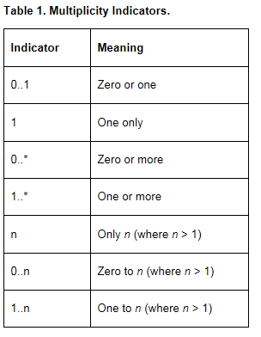
Cardinality: Multiplicity Indicators

Slide 41
Uni-directional Associations
  The uni-directional association includes a role name and a multiplicity value, but unlike the standard bi-directional association, the uni-directional association only contains the role name and multiplicity value for the known class
  The OverdrawnAccountsReport knows about the BankAccount class, and the BankAccount class plays the role of "overdrawnAccounts." However, unlike a standard association, the BankAccount class has no idea that it is associated with the OverdrawnAccountsReport.
OverdrawnAccountsReport
BankAccount
generatedOn: Date
overdrawnAccounts
owner : String
Balance : Dollars
0..*
refresh ()
deposit (amount : Dollars)
withdrawal (amount : Dollars)

Slide 42
Association Class
In modeling an association, there are times when you need to include another class because it includes valuable information about the relationship
Use an association class tied to the primary association
An association class is represented like a normal class
The difference is that the association line between the primary classes intersects a dotted line connected to the association class

Slide 43
Association Class
  The association between the Flight class and the FrequentFlyer class results in an association class called MileageCredit
  When an instance of a Flight class is associated with an instance of a FrequentFlyer class, there will also be an instance of a MileageCredit class
Flight
FrequentFlyer
flightNumber : Integer
departureTime : Date
flightDuration : Minutes
departingAirport : String
arrivingAirport : String
firstName : String
lastName : String
frequentFlyerNumber : String
0..*
passengers
flights
0..*
MileageCredit
delayFlight (numberOfMinutes : Integer)
getArrivalTime() : Date
baseMiles : Integer
bonusMiles : Integer

Slide 44
Aggregation
Aggregation relationship: one class is a part of another class
Child class instance can outlive its parent class
Draw a solid line from the parent class to the part class
Draw an unfilled diamond shape on the parent class's association end
4 wheels are part of a car.
The wheels can also exist
without being part of a car.
Car
wheels
Wheel
4

Slide 45
Composition
Composition aggregation relationship: another form of the aggregation relationship
Child class's instance lifecycle is dependent on the parent class's instance lifecycle
Drawn like the aggregation relationship, but this time the diamond shape is filled
A company consists of
at least one or more departments. A department
cannot exist without a company it belongs to.
Company
theDepartment
Department
1..*

Slide 46
Interfaces
An interface is a class that has no instances
It can be used for concepts that are rather abstract
Classes can provide (implement) an interface
Interfaces may inherit from other interfaces
We use ‘<<interface>>’ to denote an interface
Interface class implies Realization relationship interface class and the implementation class. The implementation class is said to realize the abstract class.

Slide 47
Interfaces
Both the Professor and Student classes implement the Person interface (denoted by the dashed line)
Both provide first and last name, as specified in the interface
Each Person must either be an instance of Professor or Student
<<interface>>
Person
firstName : String
lastName : String
Professor
Student
salary : Dollars
major : String

Slide 48
UML Exercise
Identify classes and relationships (associations, inheritance, aggregation, composition)
Draw a UML Class Diagram
A sports club is made up of a number of teams. Teams are, for example, a football team or a rugby team. Every team consists of a number of players. A coach trains a team. In a football tournament there are several groups which in turn consist of several football teams.

